Slide 1
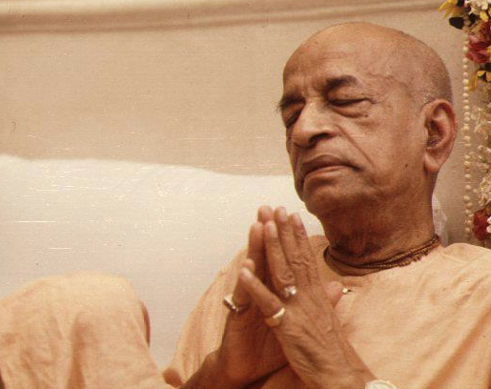
Mayapur - Bangladesh Emergency COVID relief appeal
Version# 2
Help Devotees breathe…
Notes:
Version#2

Slide 2
The 2nd wave of Covid has hit Mayapur & Bangladesh Yatras Even Harder !

Slide 3
Shri Dham Mayapur
A vibrant community of
7000 devotees and 65000 Dham Vasis is dealing with both, loss of lives and livelihoods.

Slide 4
And in Bangladesh…
Thousands of devotee families
need urgent food relief assistance.

Slide 5
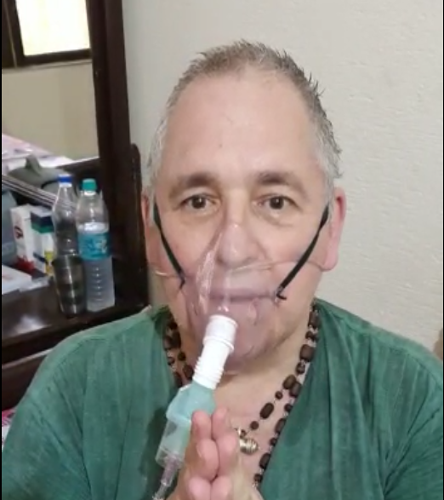
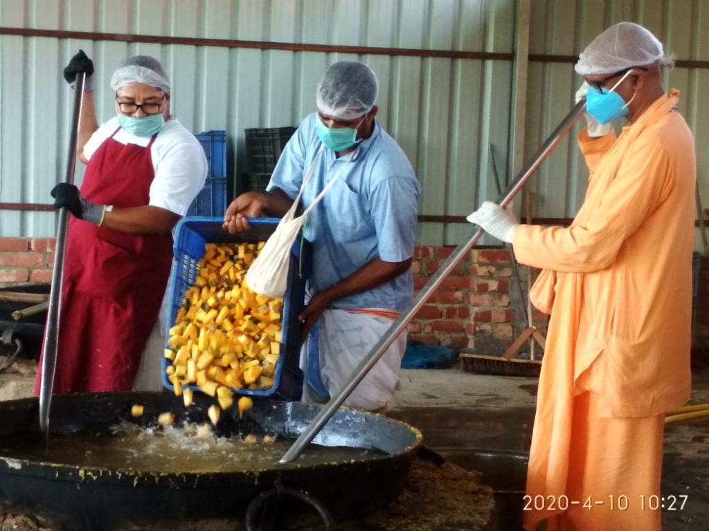
We can’t save lives without you!

Slide 6
Medical Aid Required
500,000 USD
Oxygen Plant
Subsidized Tests
Additional medical staff
Medicine sponsorship
Diet Sponsorship
Exclusive Covid care center

Slide 7
Prasadam Aid
300,000 USD
1.5 million Prasadam plates to be served
Per plate is just 20 cents
Your 1 dollar can feed 5 persons !
$200,000
for Mayapur
$100,000
for Bangaldesh

Slide 8
Consolidated Aid requirement
800,000 USD
Medical Aid
For Mayapur Region
$ 500,000
Prasadam Aid
For Mayapur Region
$ 200,000
Prasadam Aid
For Bangladesh
$ 100,000

Slide 9
Make your contribution NOW to Sri Dham Mayapur !

Slide 10
Your help can make a difference !
For
Mayapur
Contribute via PayPal by using the id
supportmayapur@mvtrust.org
And avail tax benefits under section 501(c)(3)
Please mention Covid2help in the remarks section while making the payment.

Slide 11
Your help can make a difference !
For
Mayapur
To contribute via Payment Gateway (Razorpay)
visit
https://servemayapur.com/

Slide 12
Your help can make a difference !
For
Mayapur
For Indian citizens : Net Banking | Cheque deposit | Cash deposit
Bank Name: Kotak Bank
Account Name: International Society For Krishna Consciousness Account No: 8512103714 RTGS / IFSC Code: KKBK0006570 Branch: H. B. Sarani, Kolkata.
Please mention Covid2help in the remarks section while making the payment.

Slide 13
Make your contribution NOW to Bangladesh Yatra !

Slide 14
Your help can make a difference !
For
Bangladesh
Contribute via PayPal by using the id
covidbangladesh@iskcononline.com
And avail tax benefits under section 501(c)(3)
Please mention Covid2help in the remarks section while making the payment.

Slide 15
Your help can make a difference !
For
Bangladesh
Contribute through Net Banking | Cheque deposit | Cash deposit
Bank Name: AB Bank Limited Account Name : ISKCON Account No: 4013-593491-300 SWIFT Code: ABBL-BDDH-013 Branch: Nawabpur Road Branch, Dhaka, Bangladesh.
Please mention Covid2help in the remarks section while making the payment.

Slide 16
Enquiries
Please connect with us at
Email : iskcon.mso@gmail.com
Contact number : +91-8884-848-248

Slide 17
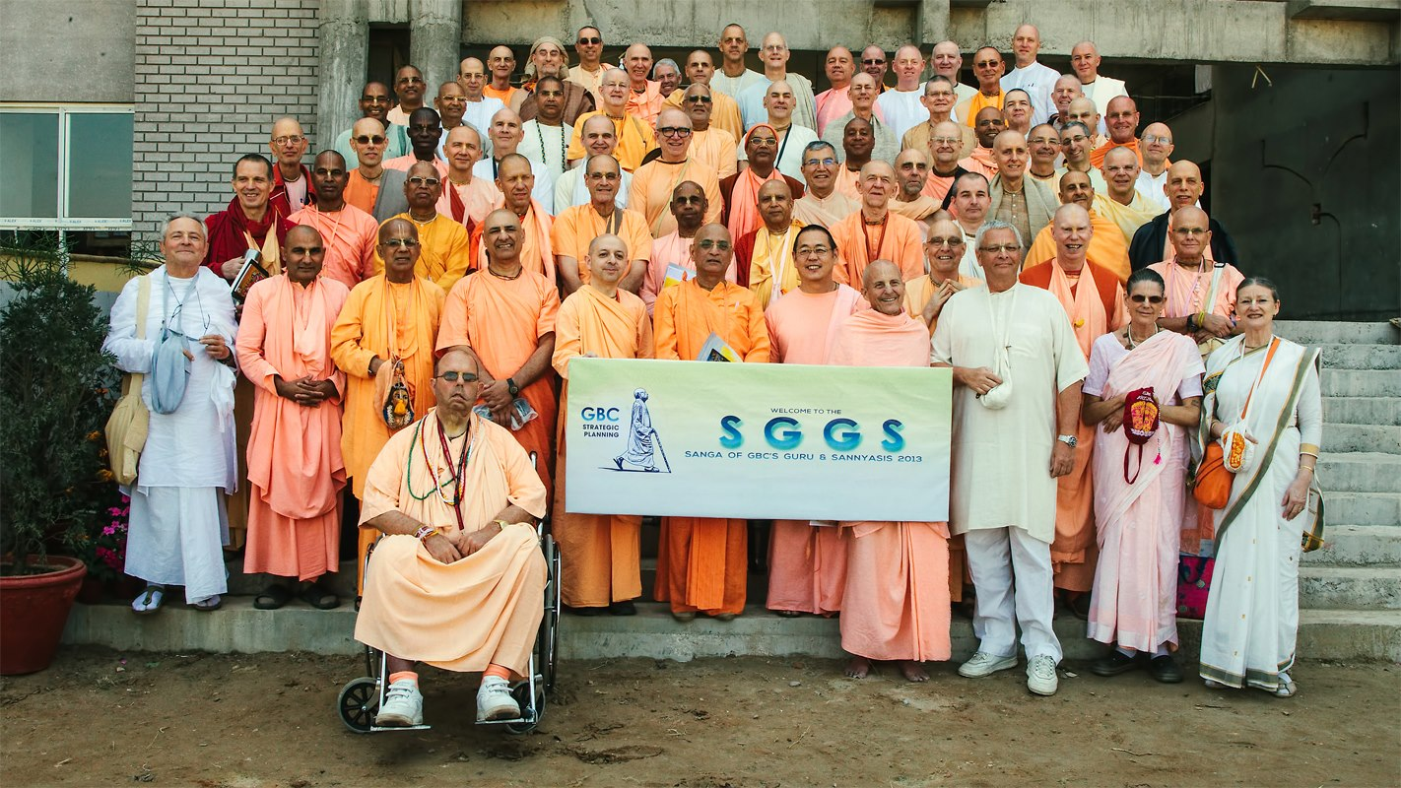
A GBC initiative to
Save Lives & Sustain Lives.

Slide 18
“Thank You!”
Jai Srila Prabhupada.
Notes:
A GBS mission to saev devotee lives.

